Slide 1
Micro-Credit Defaulter Project
By-Rahul Kumar

Slide 2
Data Preparation
With the help of Pandas Library We will upload our data to Jupyter Notebook.
Once our data is uploaded with the help of predefined method (i.e. read_csv), we can read data for further processing.
Two types of variable can be seen in the data:-
Dependent Variable
Independent Variable

Slide 3
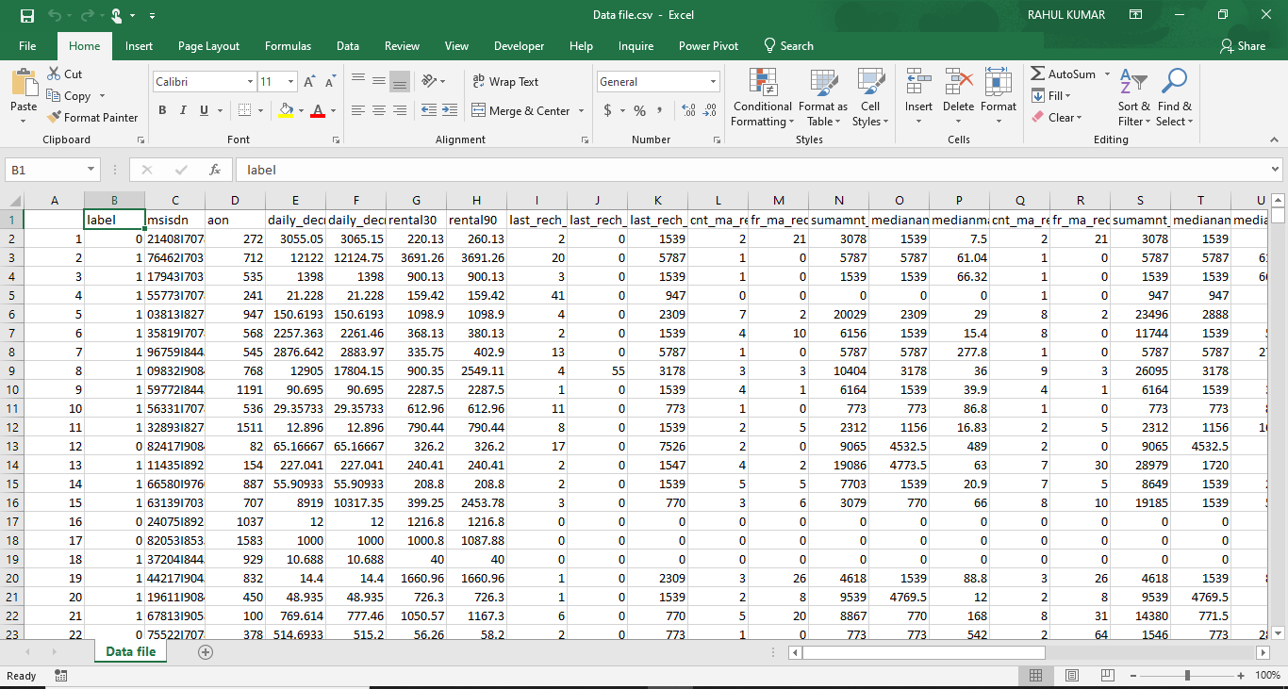
Data file in CSV format

Slide 4
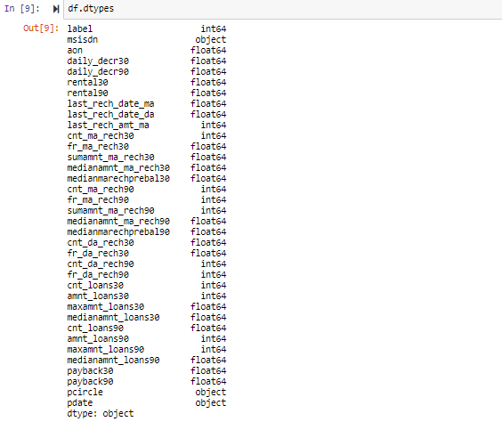
Label is an independent variable where as all of the other element are dependent variable.

Slide 5
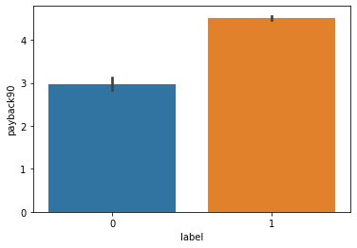
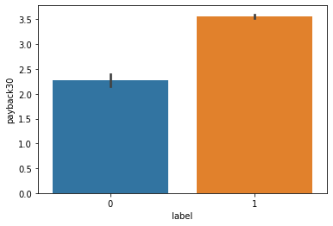
In the label, value 0 represent the failure of the payment and 1 Represents the successor who has paid credit successfully.
Based on the given data following are the our initial findings:-

Slide 6
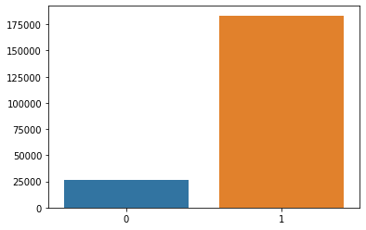
The average payback time is less for the defaulter cases as compare to other category in both of the scenarios.
From the above graphical chart we see that out of 200000 subscribers on 25000 did not pay the credit back.

Slide 7
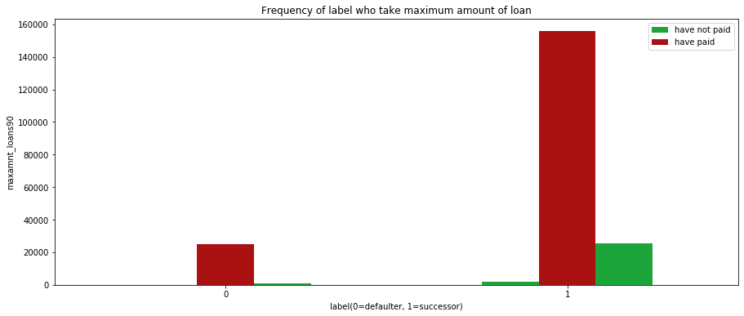
From the above graphical chart following is our finding:-
The subscriber who have not paid the credit is less the 10% of the total who have taken credit.

Slide 8
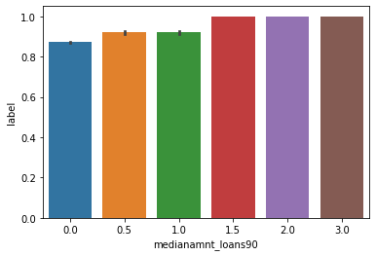
Median of amounts of loan taken by the user in last 90 days.

Slide 9
DATA PREPROCESSING
The Complete data is divided in the ration of 70:30 for train and test respectively.
Pcircle column is dropped since for the current processing it was not used.
There is no null value in the dataset but there are some outliers present in the dataset which has been removed with the help of predefine methods.
Once our data is ready categorical variables are converted into the other form, which we can apply further on algorithms.

Slide 10
Evaluation Process
Evaluation Metrics:
Accuracy - it determines how often a model predicts default and non default correctly.
Precision-it calculates whenever our models predicts it is default how often it is correct.
Recall- Recall regulate the actual default that the model is actually predict.
Precision Recall Curve - PRC will display the tradeoff between Precision and Recall threshold.
Cross Validations:
K Fold cross validations , K = 5

Slide 11
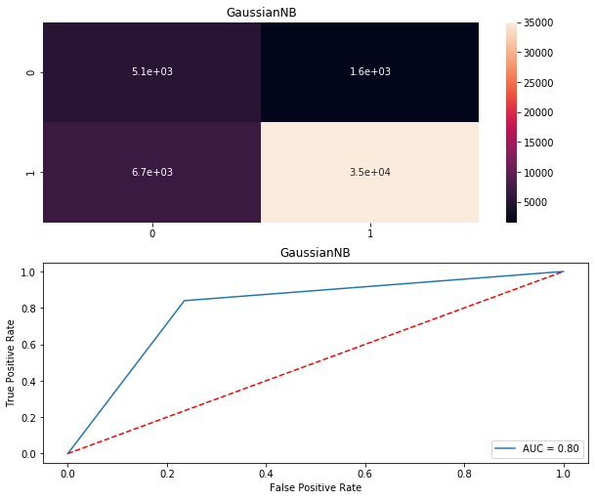
GaussianNB AUC

Slide 12
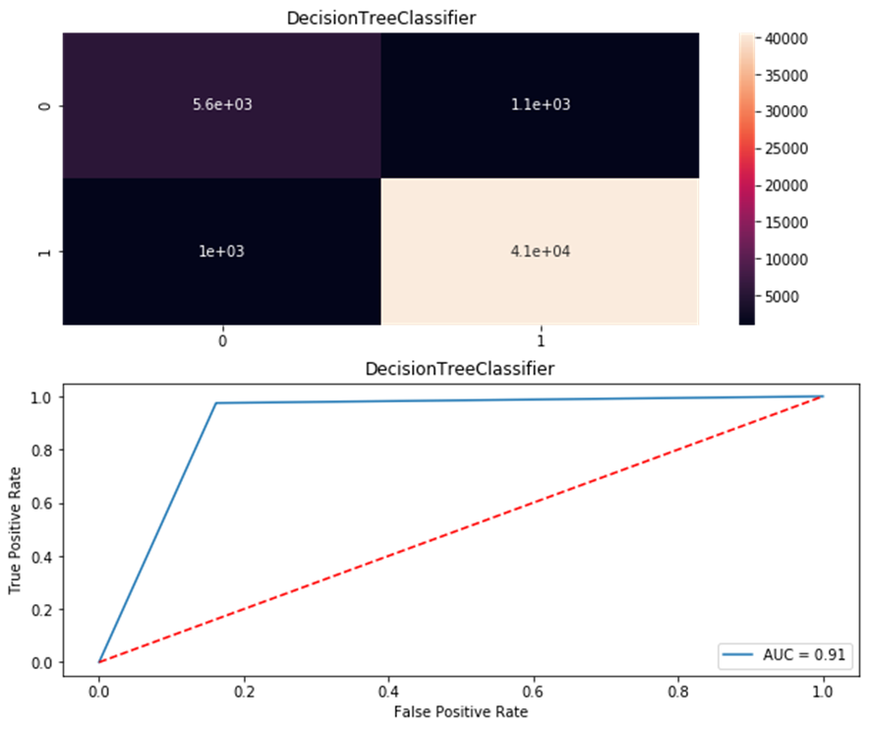
Decision Tree AUC

Slide 13
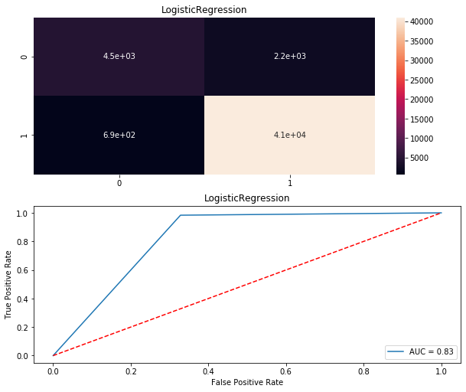
Logistic Regression AUC

Slide 14
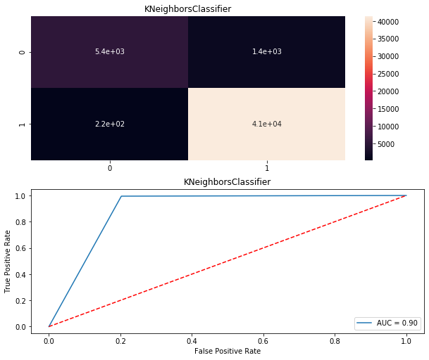
KNeighboursClassifier

Slide 15
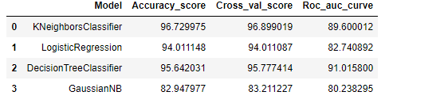
Result
From the details in the below table it is clearly understandable that we are getting best result with the help of KNeighborsClassifier so we save this model with the help of joblib Library.

Slide 16
Conclusion
In this dataset firstly if we look at the data , we have to predict the defaulters so we take it as a label as a Y variable and rest column was taken as a X before splitting the dataset we checked the datatype and change the datatype of the columns and see the correlation , null values , description and pair plot check the outlier the 48128 rows are get removed as outlier. Then we split the data into x and y and apply the standard scaler in x and in y the label encoder. Since from the table we see that Kneighbors Classifier, Logistic Regression, Decision Tree Classifier and Gaussian NB all are performing very well. We choose Kneighbors Classifier as our final model because it perform well on the dataset with
Accuracy_Score = 96.72997522708505
Cross_Val_Score = 96.89901941495318
roc_auc_score = 89.60001198465963

